Slide 1
Solo Project: DND Character Database
John Brockman

Slide 2
Brief
Solo Project
CRUD Integration
Full Stack Application
Using OOP + Core Java Skills
Relational Database
Fully Tested

Slide 3
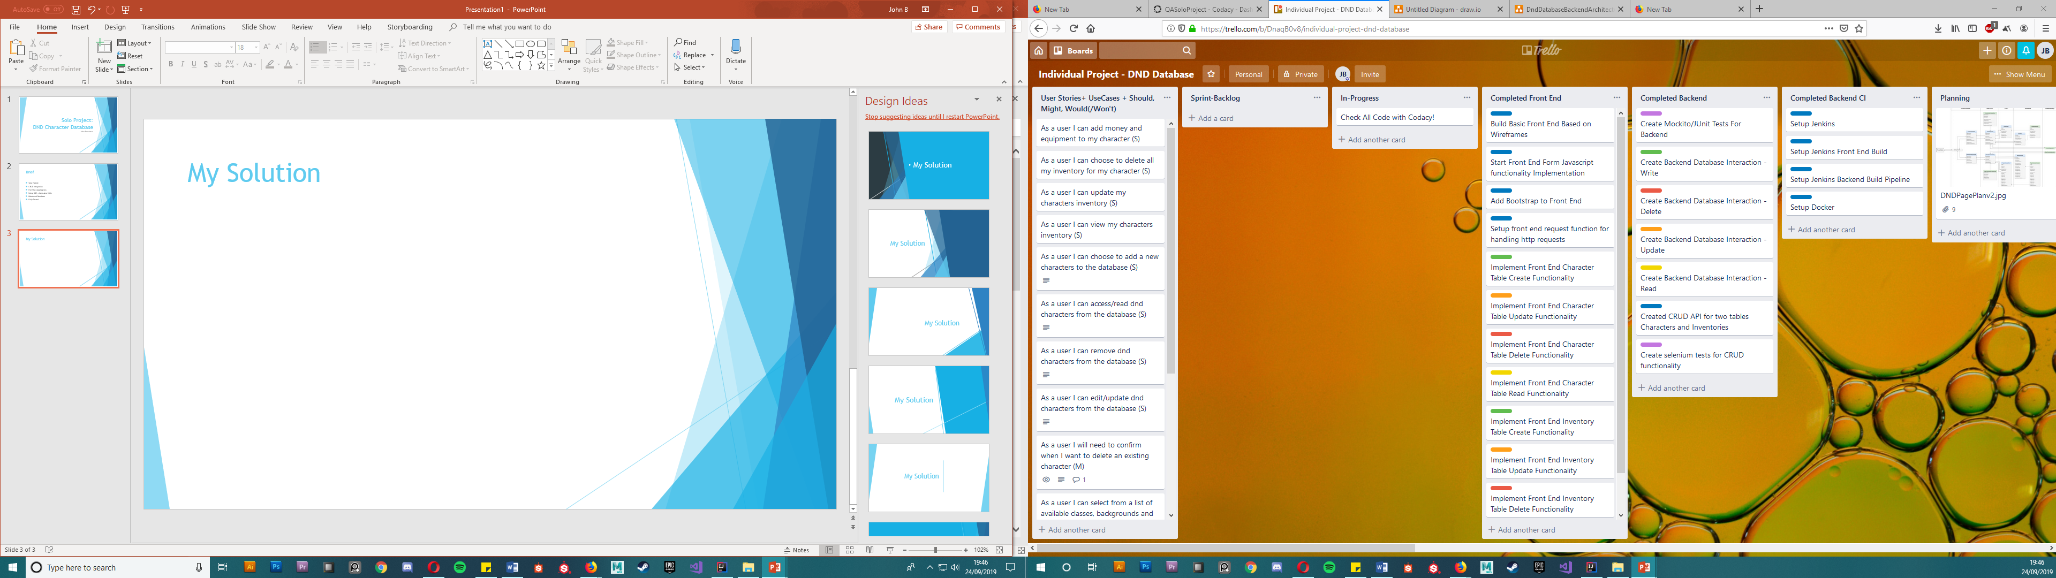
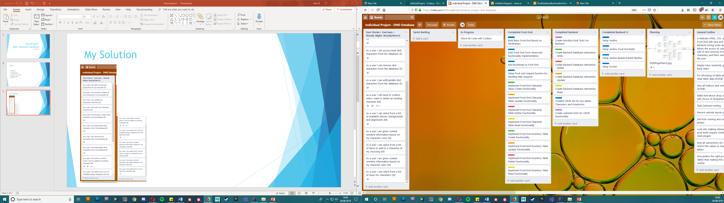
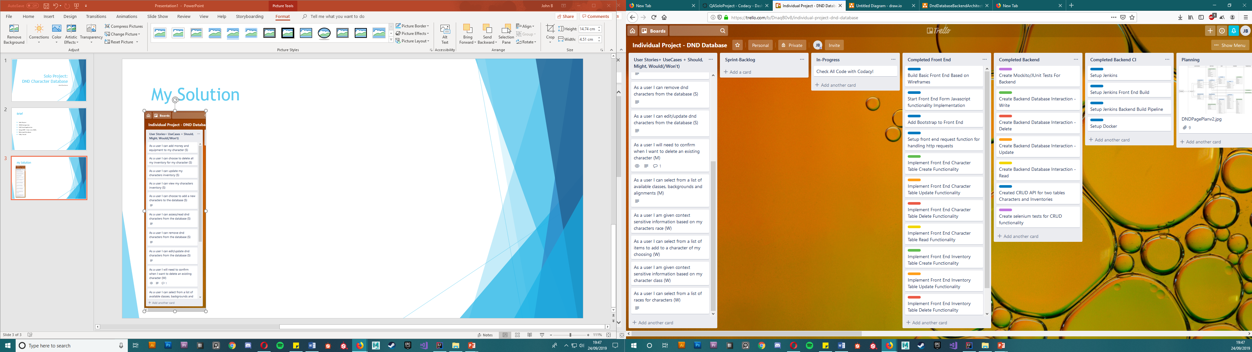
My Solution

Slide 4
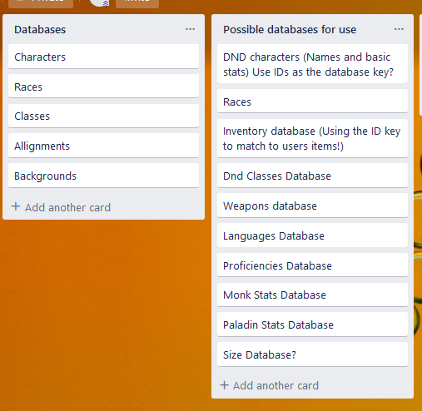
My solution

Slide 5
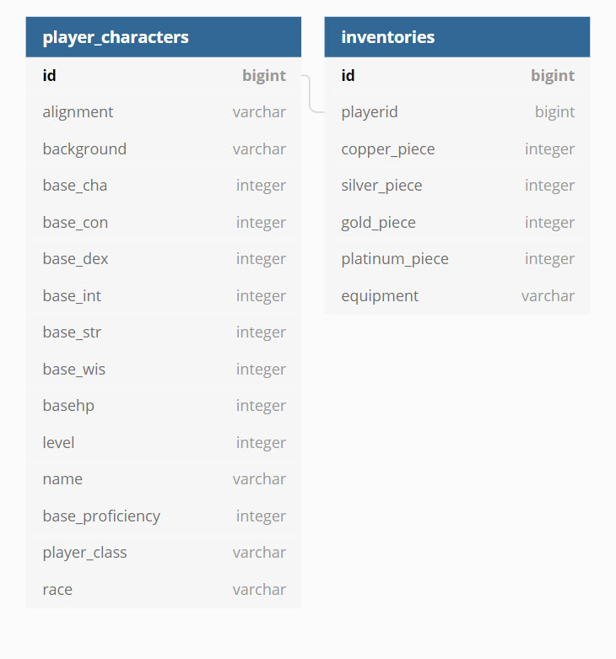
My Solution

Slide 6
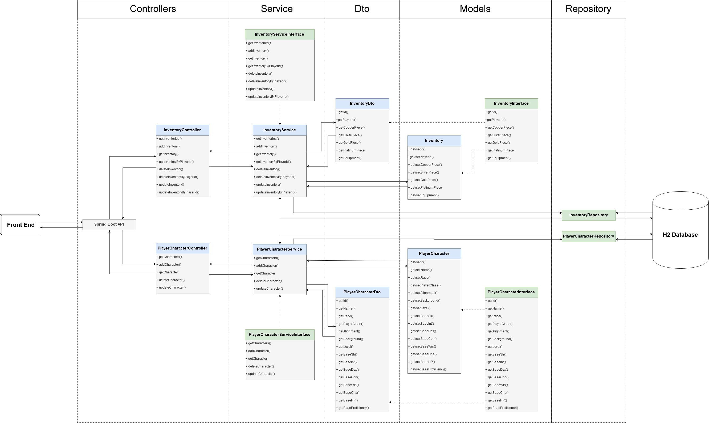
API Development

Slide 7
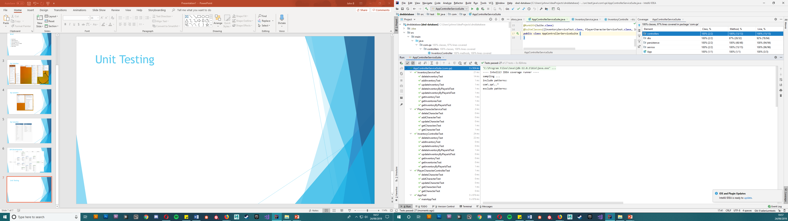
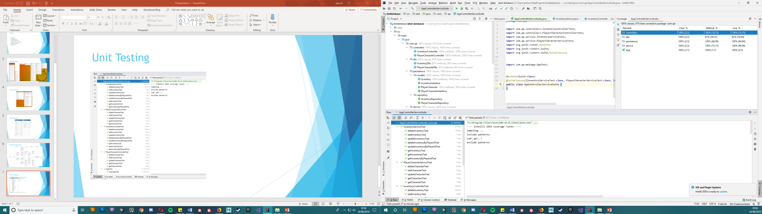
Unit Testing (Junit + Mockito)

Slide 8
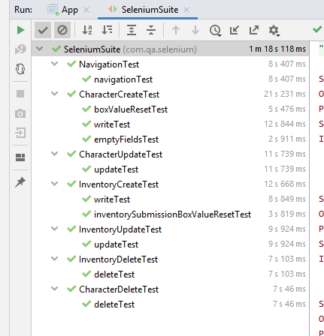
Selenium Tests

Slide 9
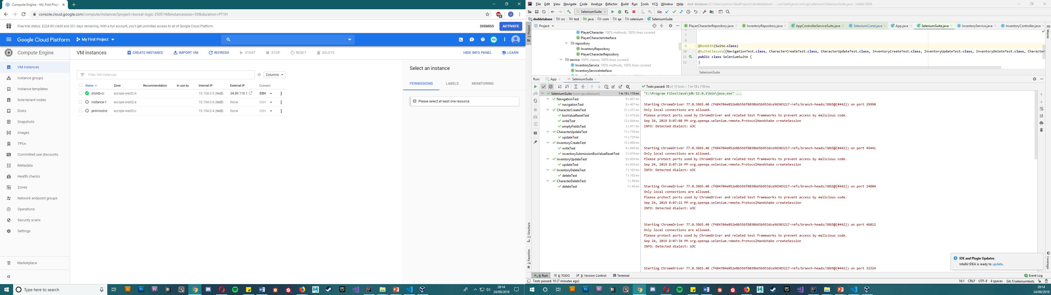
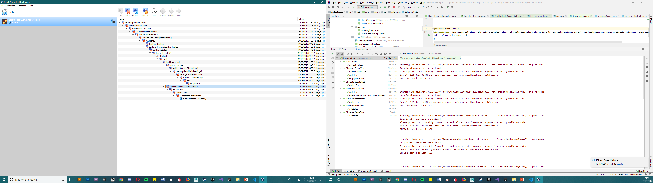
Jenkins CI Integration and GCP

Slide 10
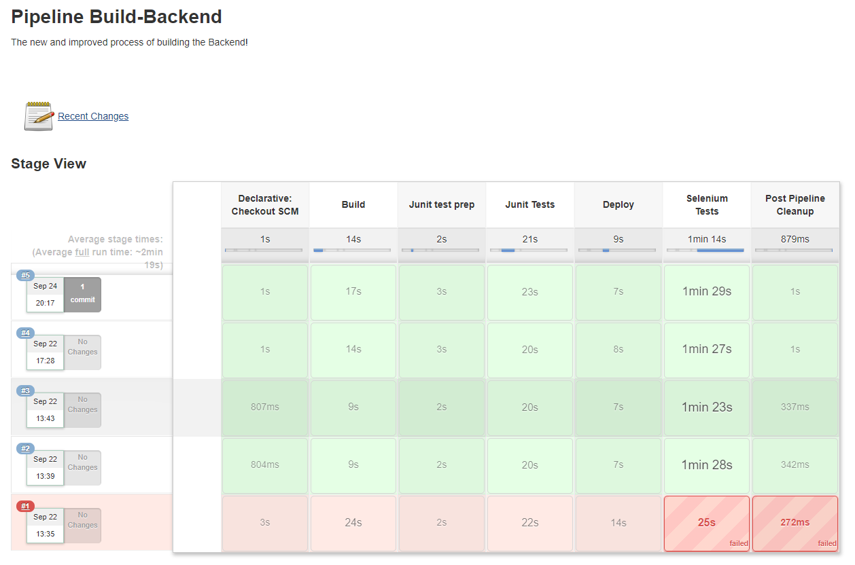
Jenkins CI Integration and GCP

Slide 11
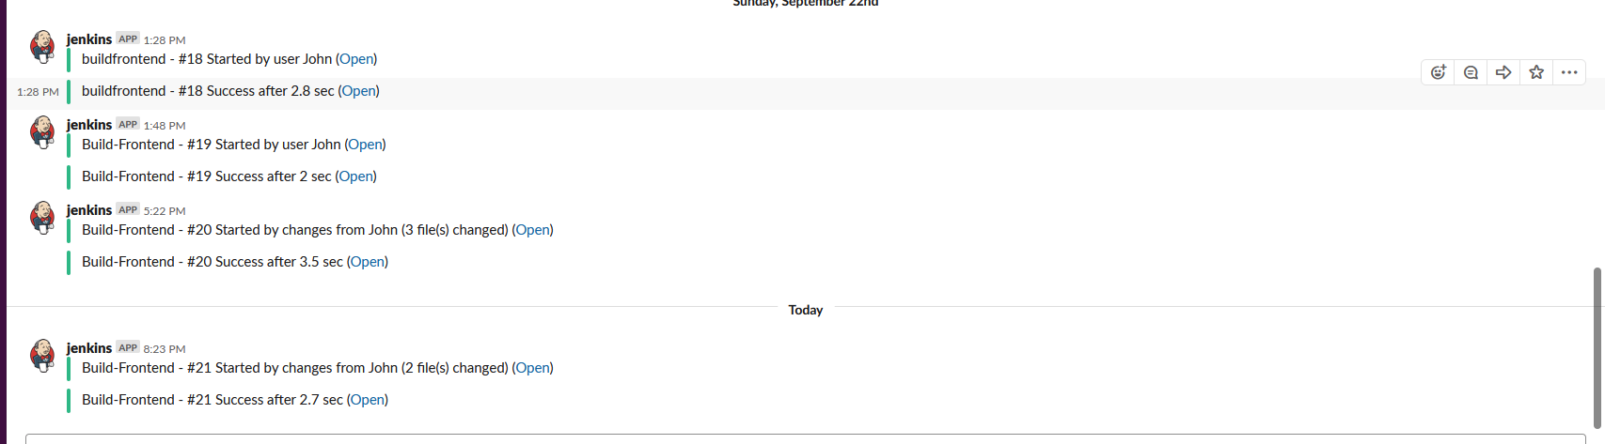
Jenkins CI Integration and GCP

Slide 12
Code Quality Checking

Slide 13
Code Quality Checking

Slide 14
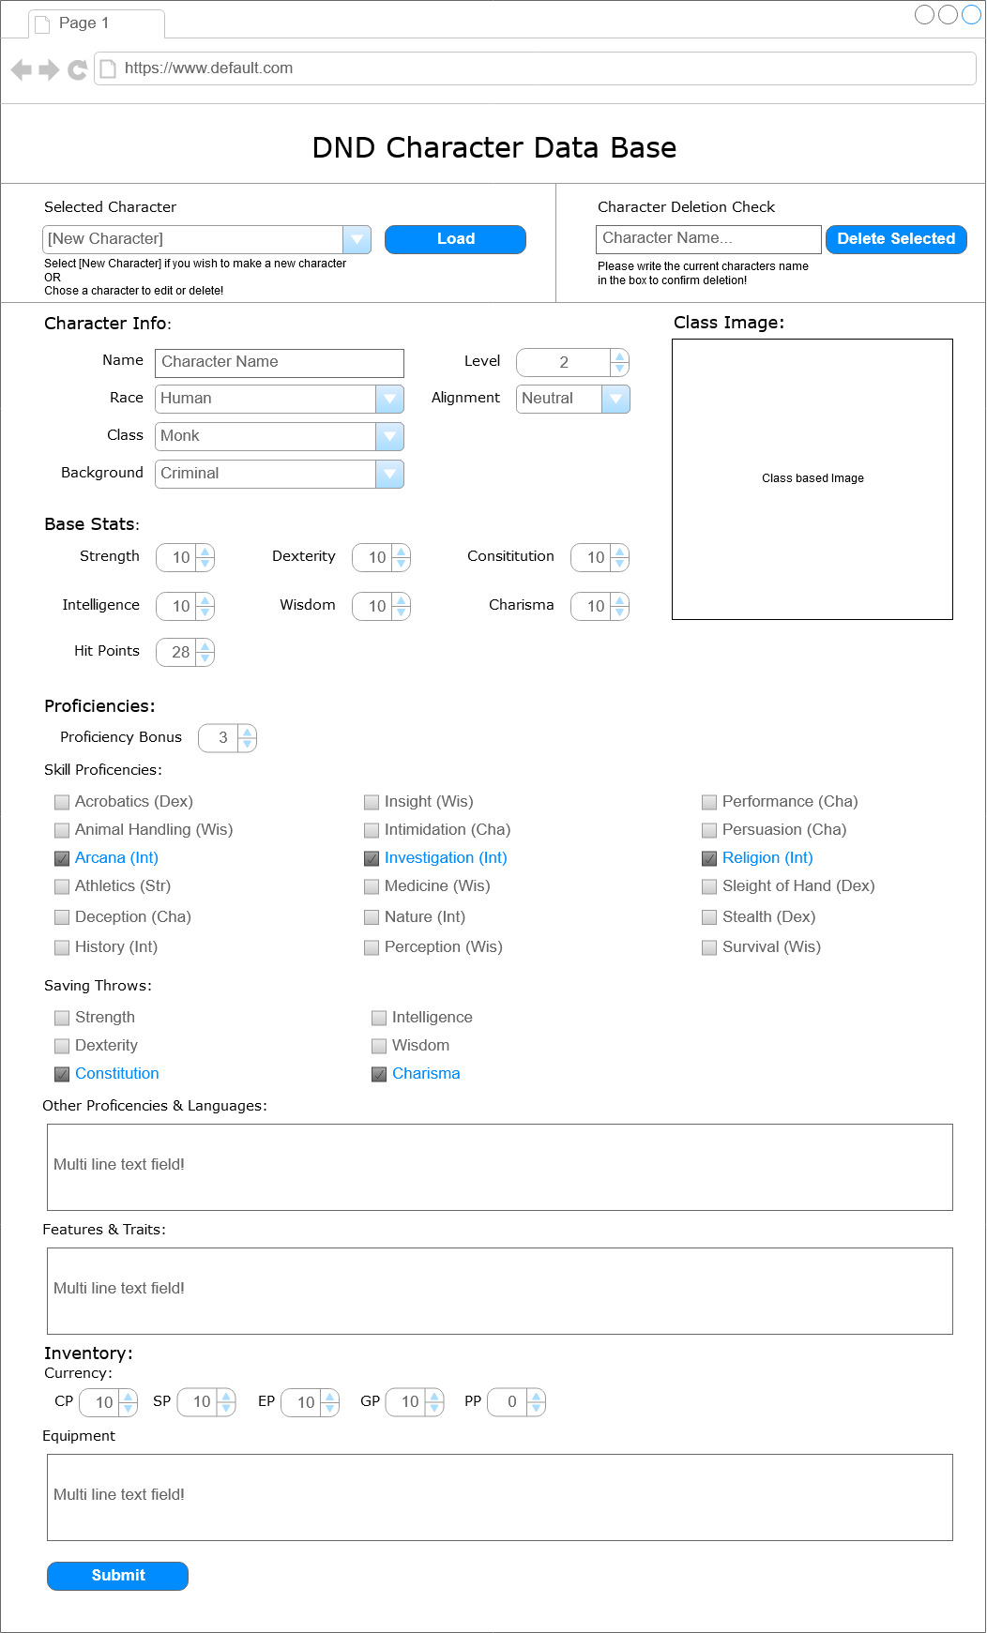
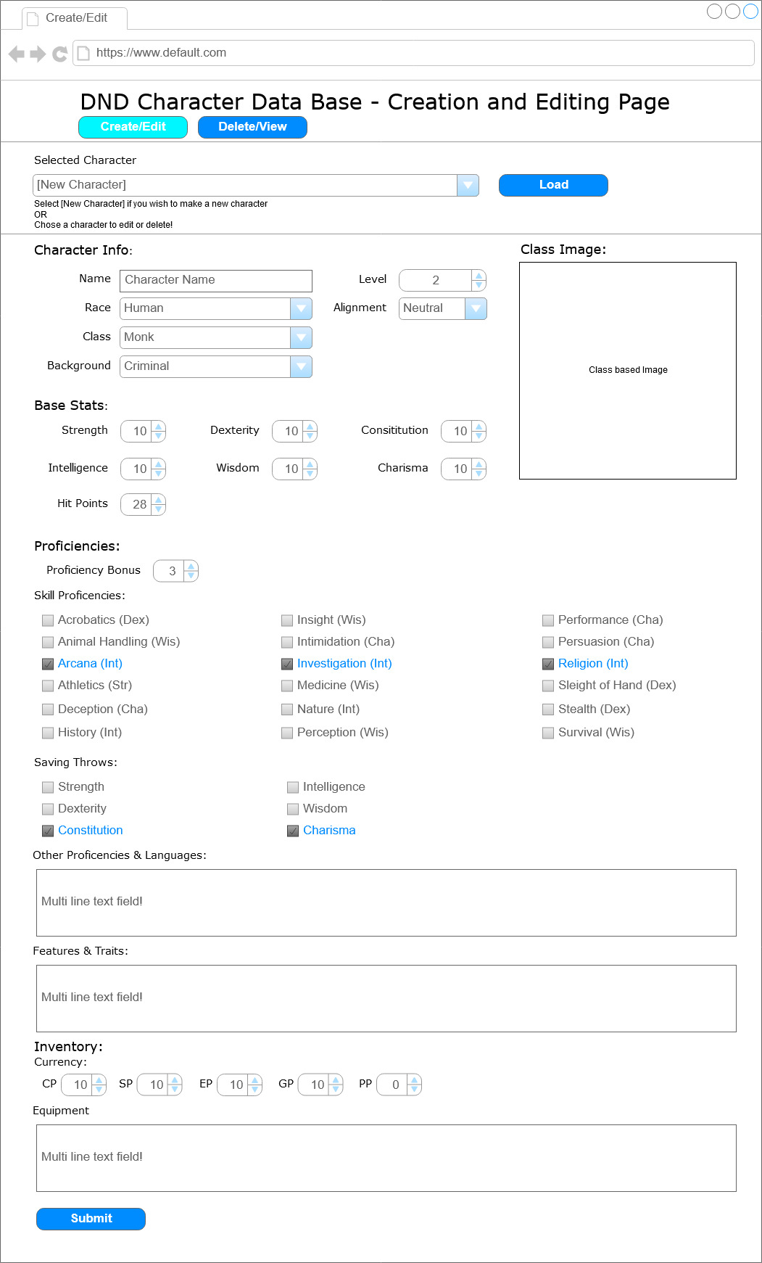
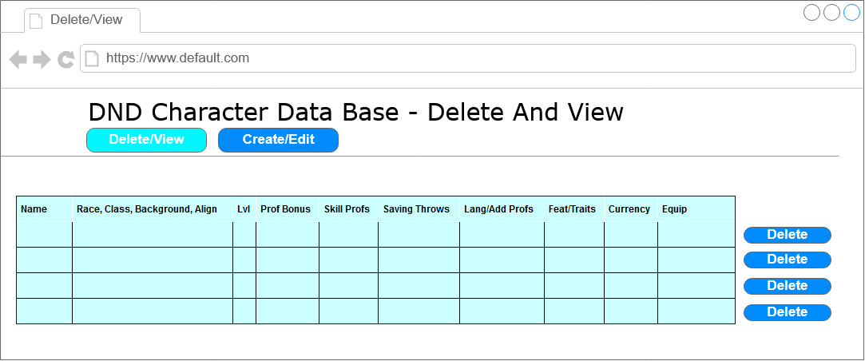
Front End - Initial Wireframes

Slide 15
Front End - HTML, CSS, Bootstrap, JavaScript

Slide 16
Front End - HTML, CSS, Bootstrap, JavaScript

Slide 17
Front End - HTML, CSS, Bootstrap, JavaScript

Slide 18
Front End - HTML, CSS, Bootstrap, JavaScript

Slide 19
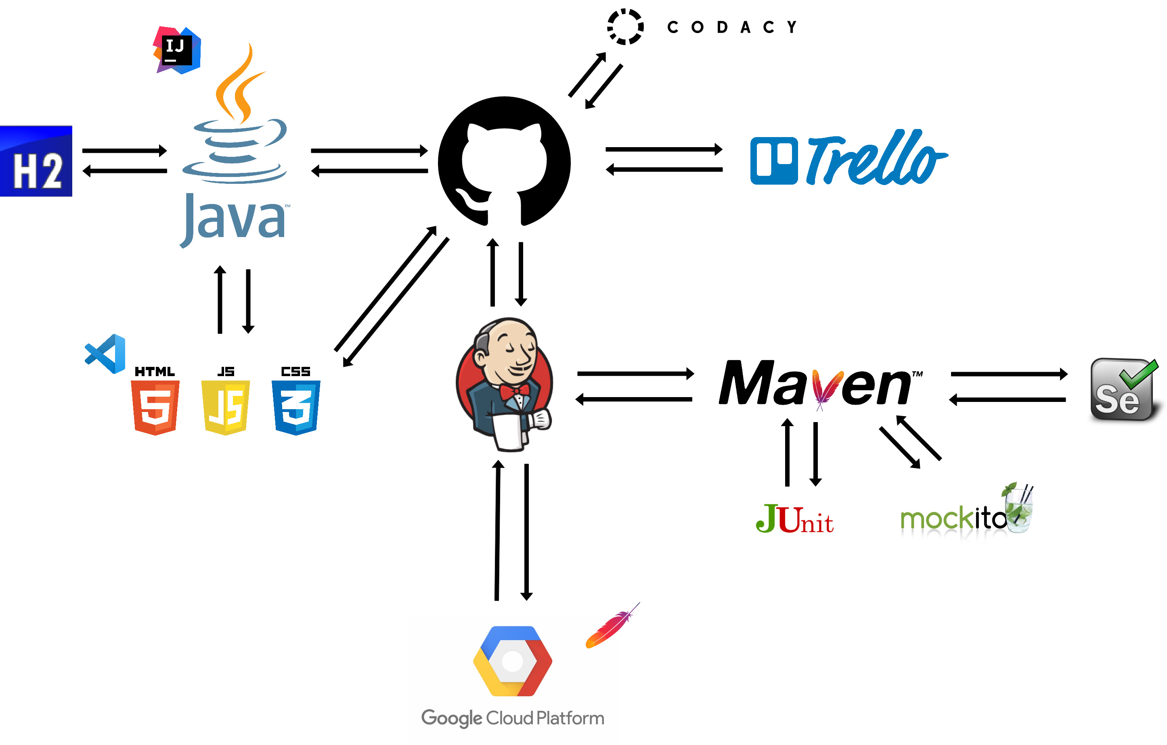
DevOps and Continuous Integration

Slide 20
Summary
What went well
Database and CRUD functionality
UX
Test Coverage
Code Quality Checking
Front End Testing
Use of CI Tools
Future Improvements
UX
Bootstrap (Modals, General Appearance)
Front End code could be cleaner
More Relational Databases:
- Items, Classes, Proficiencies

Slide 21
Demonstration
http://34.89.110.1/

Slide 22
Questions?

